Slide 1


Weekly Progress Report – Construction Projects
Projects Department

Slide 2

Disclaimer
This report is not all inclusive, nor it is intended to address the entirety of construction progress. It is concerned primarily with construction progress and is intended to provide near term management information. The report itself serves as the Agenda for the weekly/Biweekly/Monthly or as required progress meetings.

Slide 3
Introduction

Slide 4
Introduction
Purpose
This report is to be prepared by the construction contractor and submitted to the Construction Consultant and MODON Project Manager before 12:00 PM on every Wednesdays with Progress data cut off date is Tuesday. The premise behind this report and the key to successfully managing projects is to update schedules weekly.
Calendar
The complete report will serve as the agenda for the weekly site meetings. The Construction Manger will chair the meeting. Attendance shall be limited to essential personnel only.
Construction Contractor, appropriate Contractor staff, Construction Manager, Program Manager,
and MODON Project Manager shall be in attendance.
Minutes of Meeting will be taken by the Construction Manager and submitted to the Program Manager (If Applicable) within 48 hours. Minutes shall describe attendance, the conduct of the meeting, discussion items, and problem resolutions, and shall provide action items with responsible parties and due dates.
Construction Manager shall maintain the Action Items Register. At subsequent meetings, open
action items shall be discussed first.

Slide 5
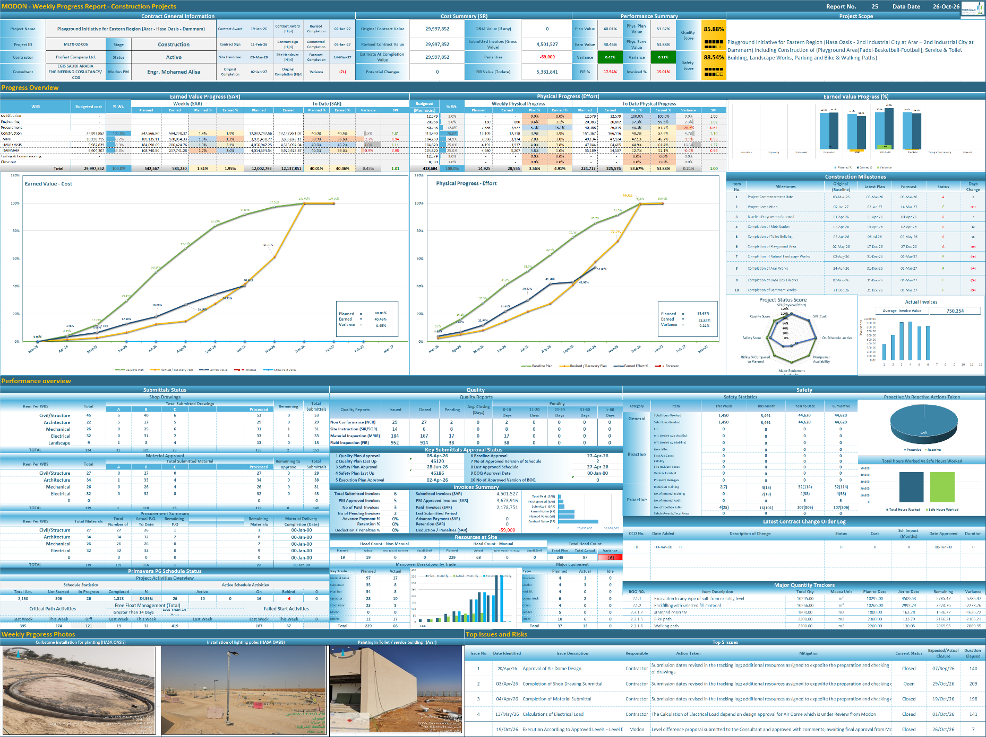
Weekly Progress Report Dashboard

Slide 6
Weekly Progress Report Attachment
Weekly Progress Report Attachement
Contractor/Consultant should ensure that the weekly progress report are supported with
required attachment.
Those attachment should include the following as a minimum requirement:
Approved Primavera P6 Schedule in .xer format.
3-5 latest progress photographs in JPG format
Updated Primavera P6 schedule in .xer format & PDF Format Three weeks look ahead in PDF format. (as per plf link)
Remaining Works in PDF format.
Any other supporting document required per the development of the project.

Slide 7
Weekly Report Areas / Sections

Slide 8
Weekly Report Areas / Sections
Contract General Information
HSE
Key Dates
Invoices
Contract Change Order Log
Progress Overview
Construction Milestones
Major Quantity Trackers
Submittals Status
Resources at Site
Shop Drawing Status
Primavera P6 Schedule Status
Material Approval Status
Testing And Commissioning
Quality
Top Issues

Slide 9
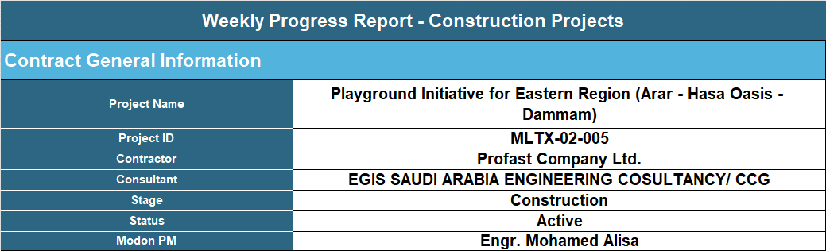
Weekly Report Areas / General Information
Contract General Information

Slide 10
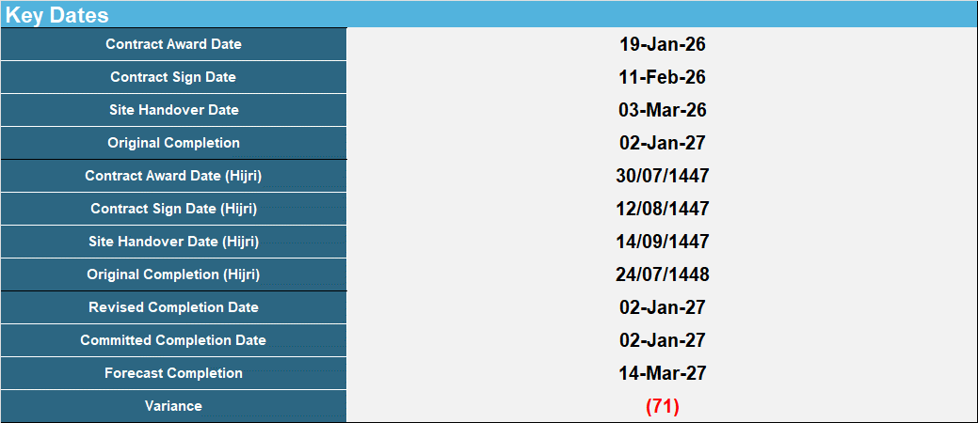
Weekly Report Areas / Dates
Key Dates

Slide 11
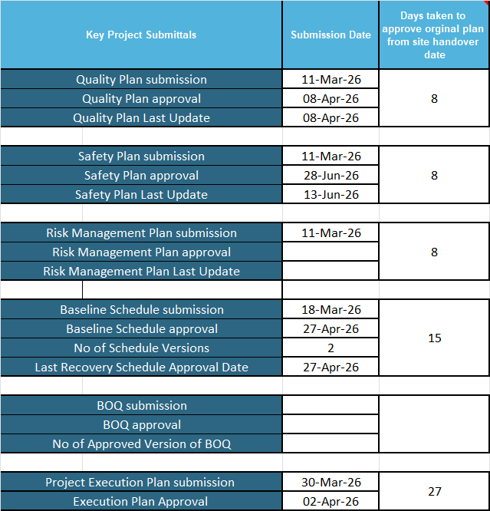
Weekly Report Areas / Dates
Key Dates

Slide 12
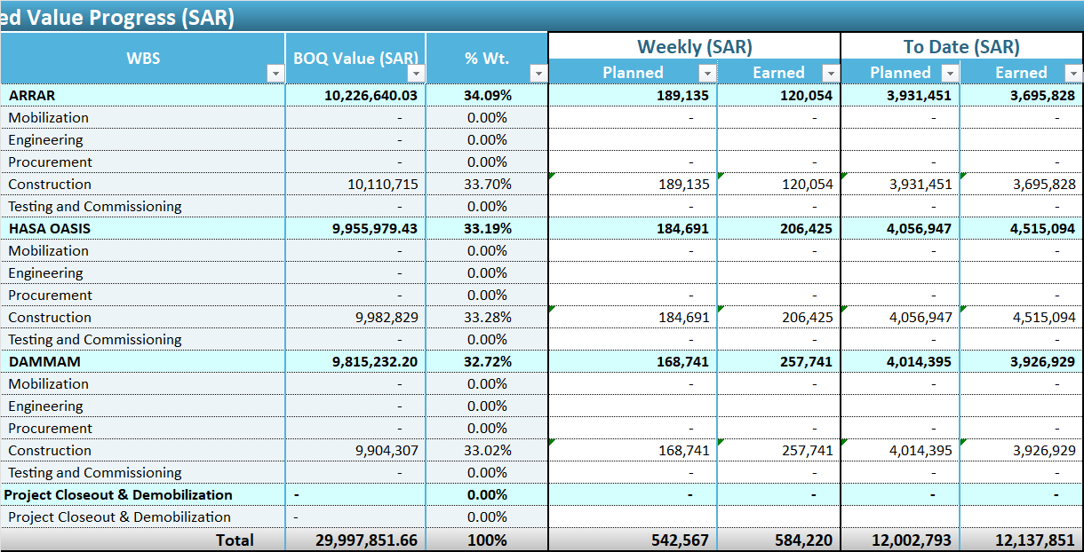
Weekly Report Areas / Progress

Slide 13
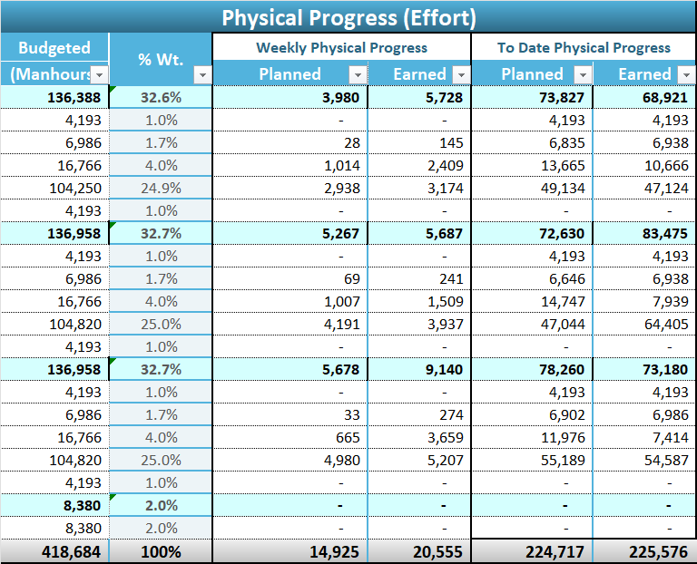
Weekly Report Areas / Progress

Slide 14
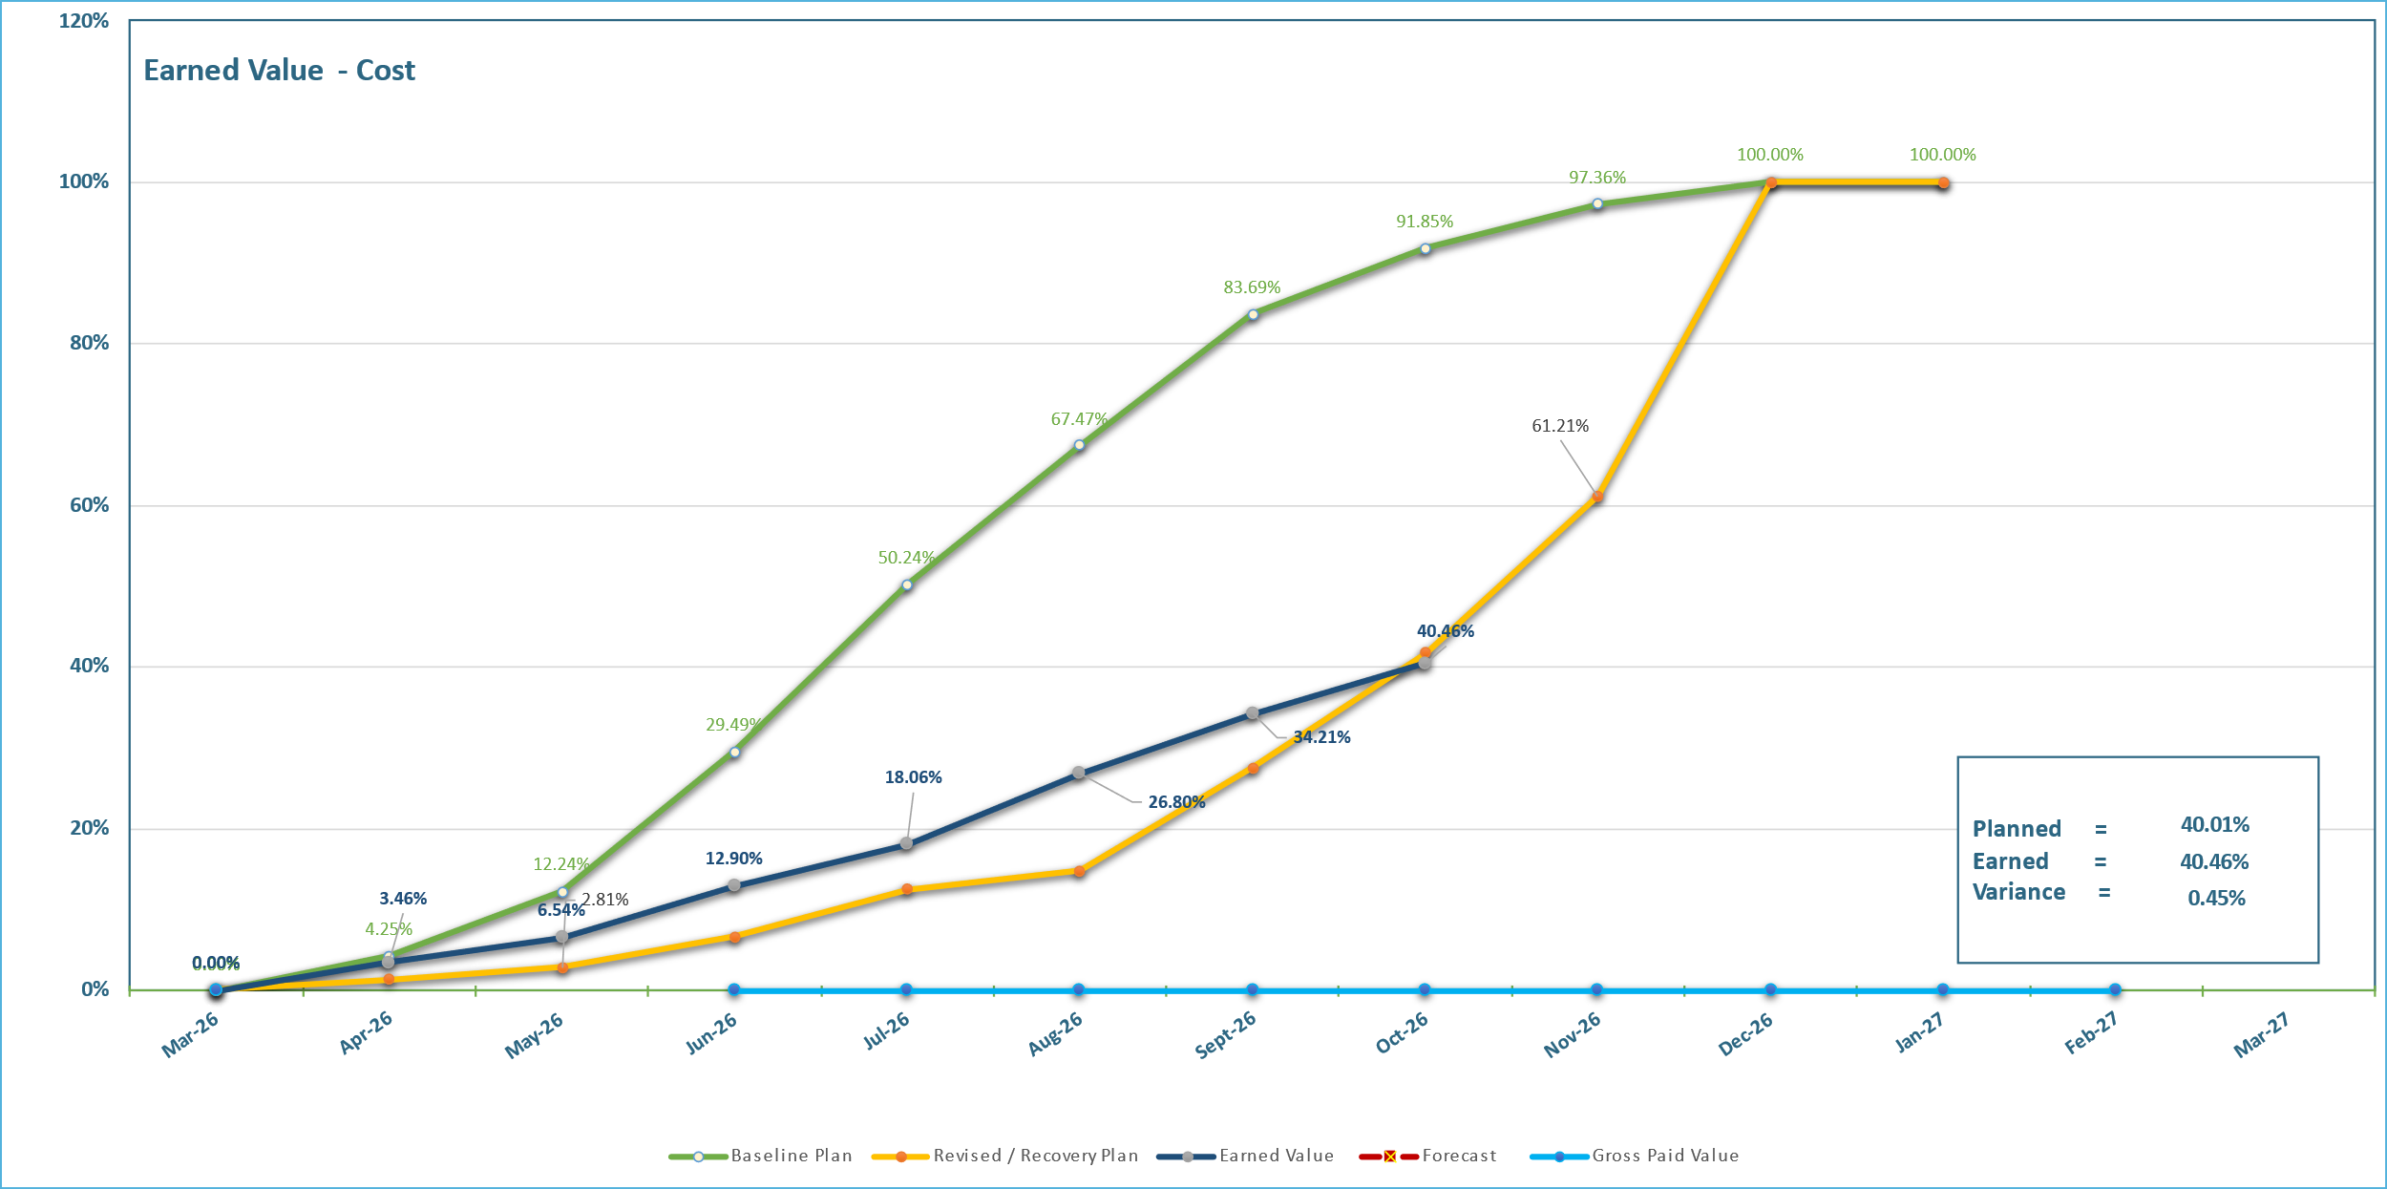
Weekly Report Areas / Progress
Progress Overview

Slide 15
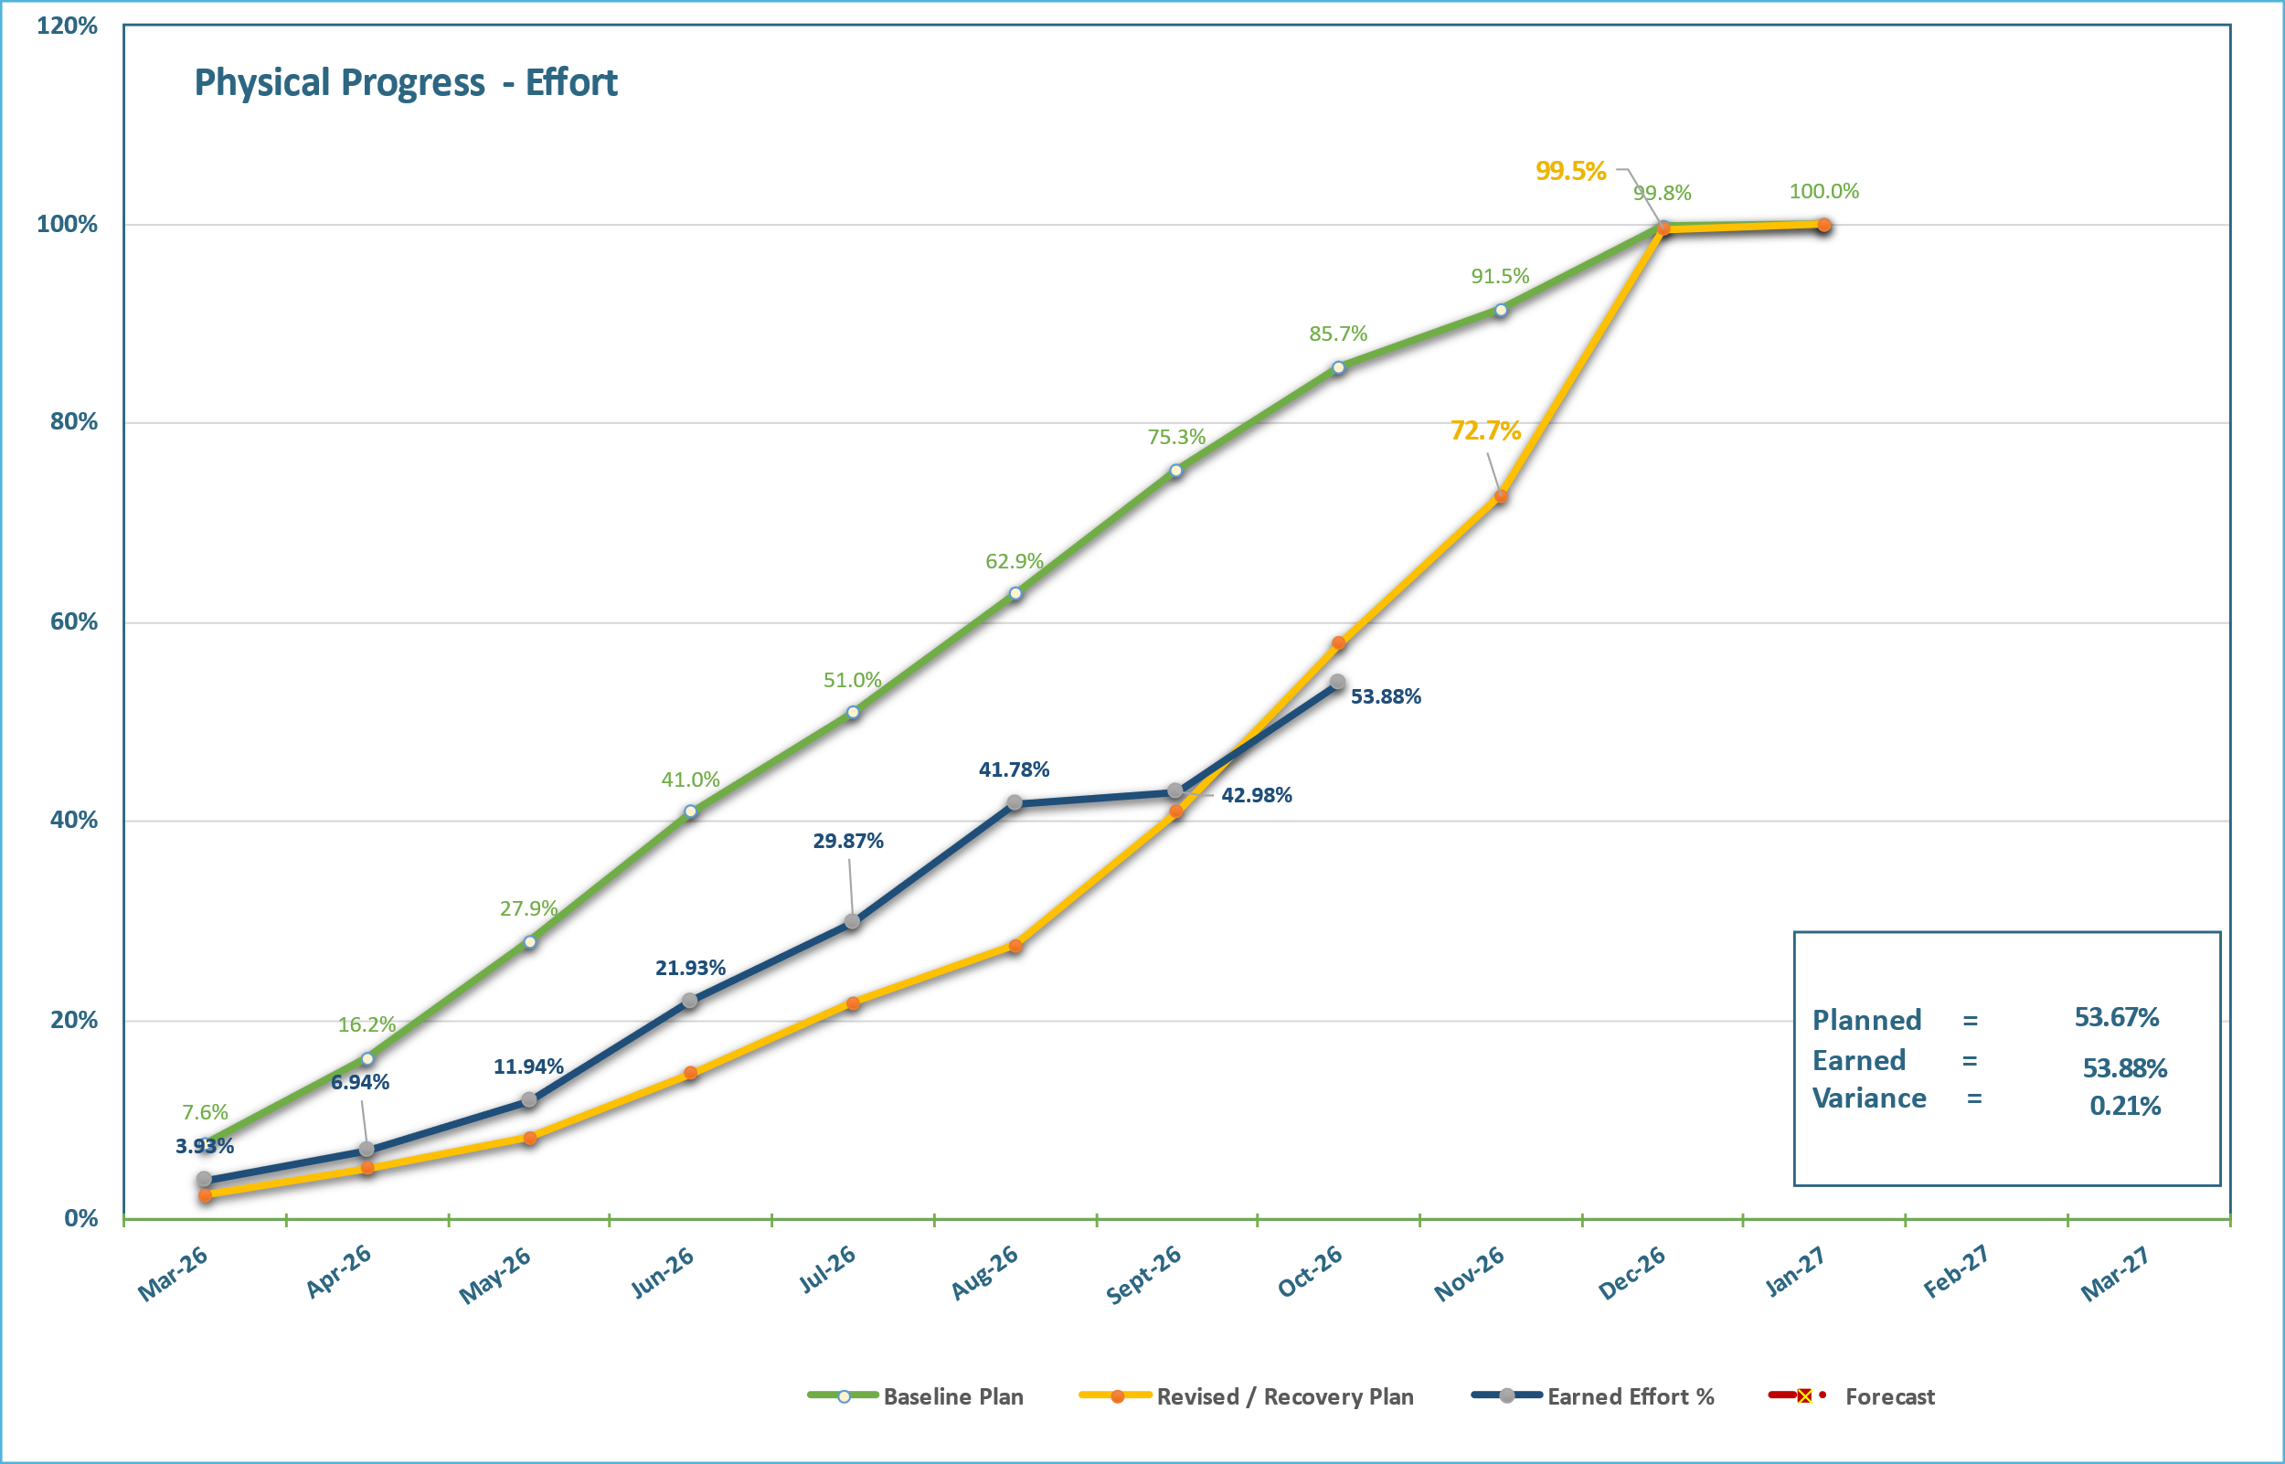
Weekly Report Areas / Progress
Progress Overview

Slide 16
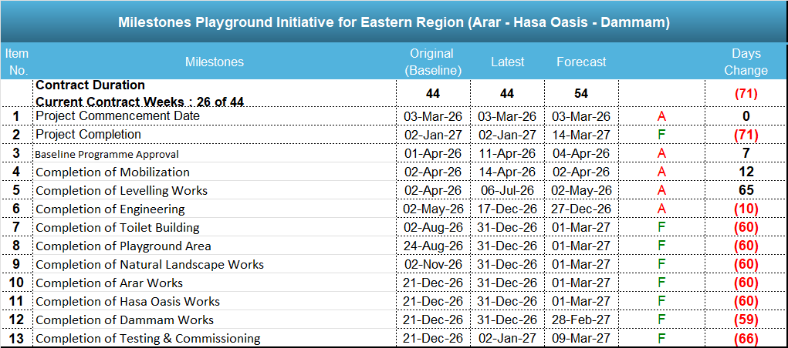
Weekly Report Areas / Milestones
Construction Milestones
Milestones Playground Initiative for Eastern Region (Arar - Hasa Oasis - Dammam)

Slide 17
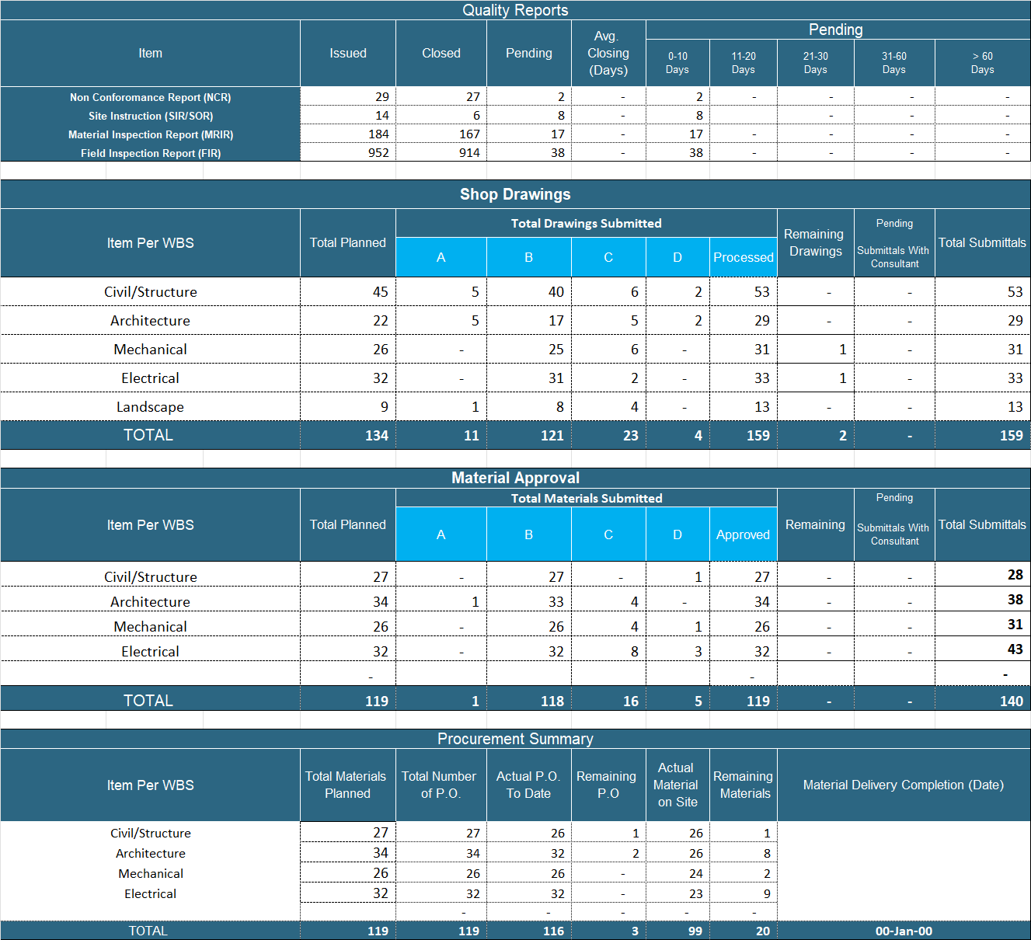
Weekly Report Areas / Quality
Quality Reports

Slide 18
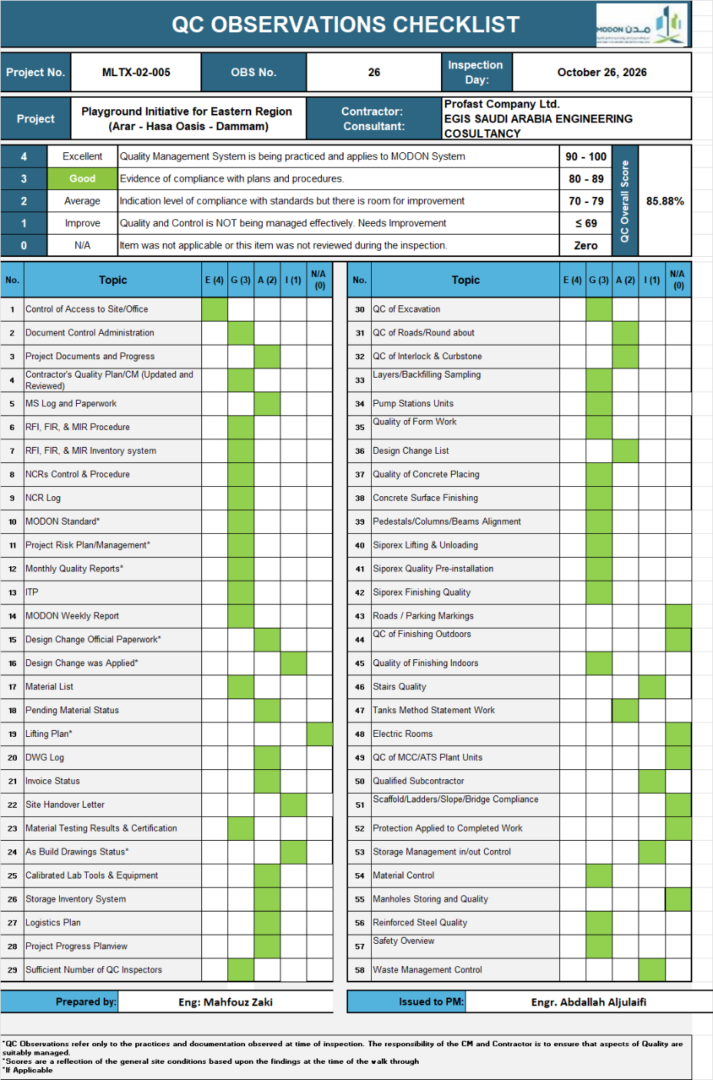
Weekly Report Areas / Quality
Quality Audit

Slide 19
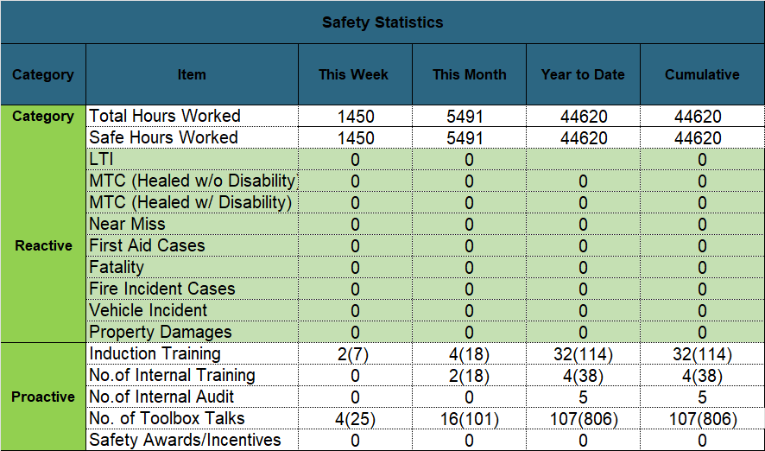
Weekly Report Areas / HSE
Health, Safety & Environmental (HSE)

Slide 20
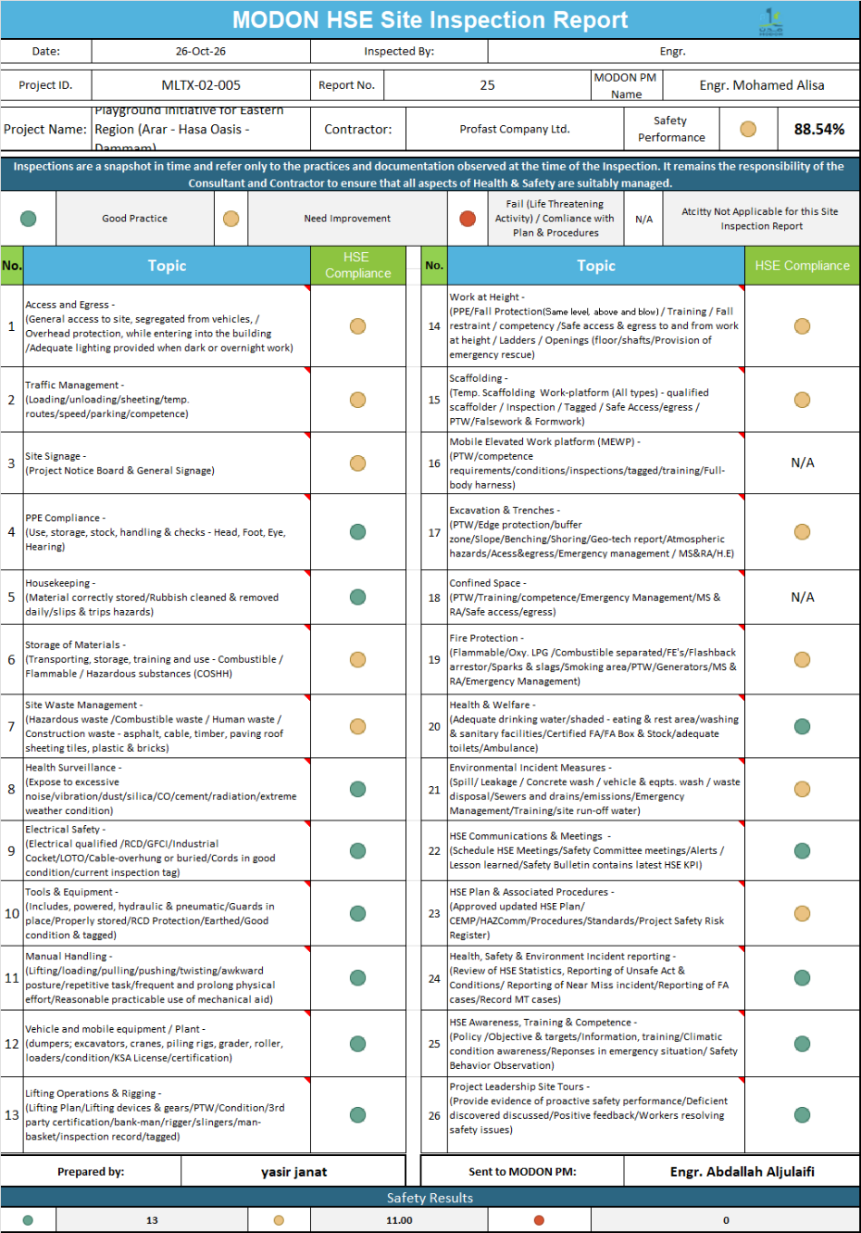
Weekly Report Areas / HSE
Health, Safety & Environmental (HSE) Audits

Slide 21
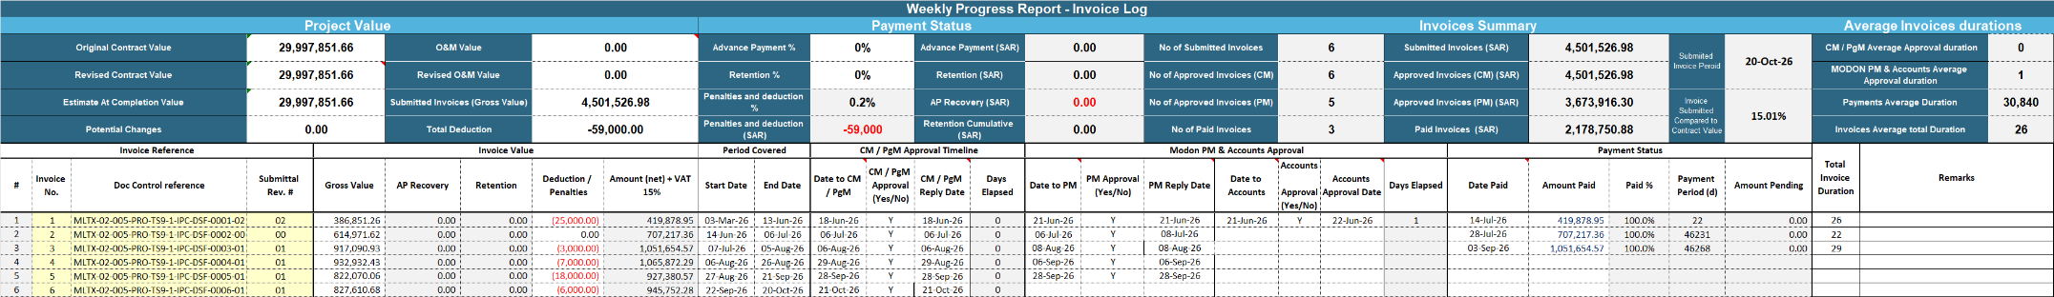
Weekly Report Areas / Invoices
Invoice Log
Weekly Progress Report - Invoice Log

Slide 22
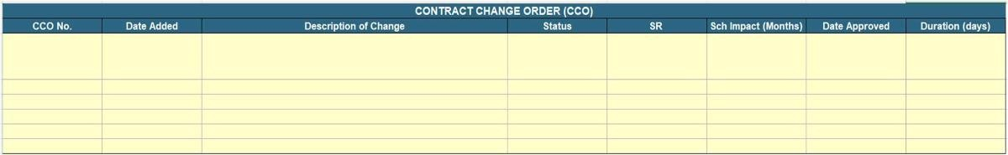
Weekly Report Areas / CCOs
Contract Change Orders (CCOs)

Slide 23
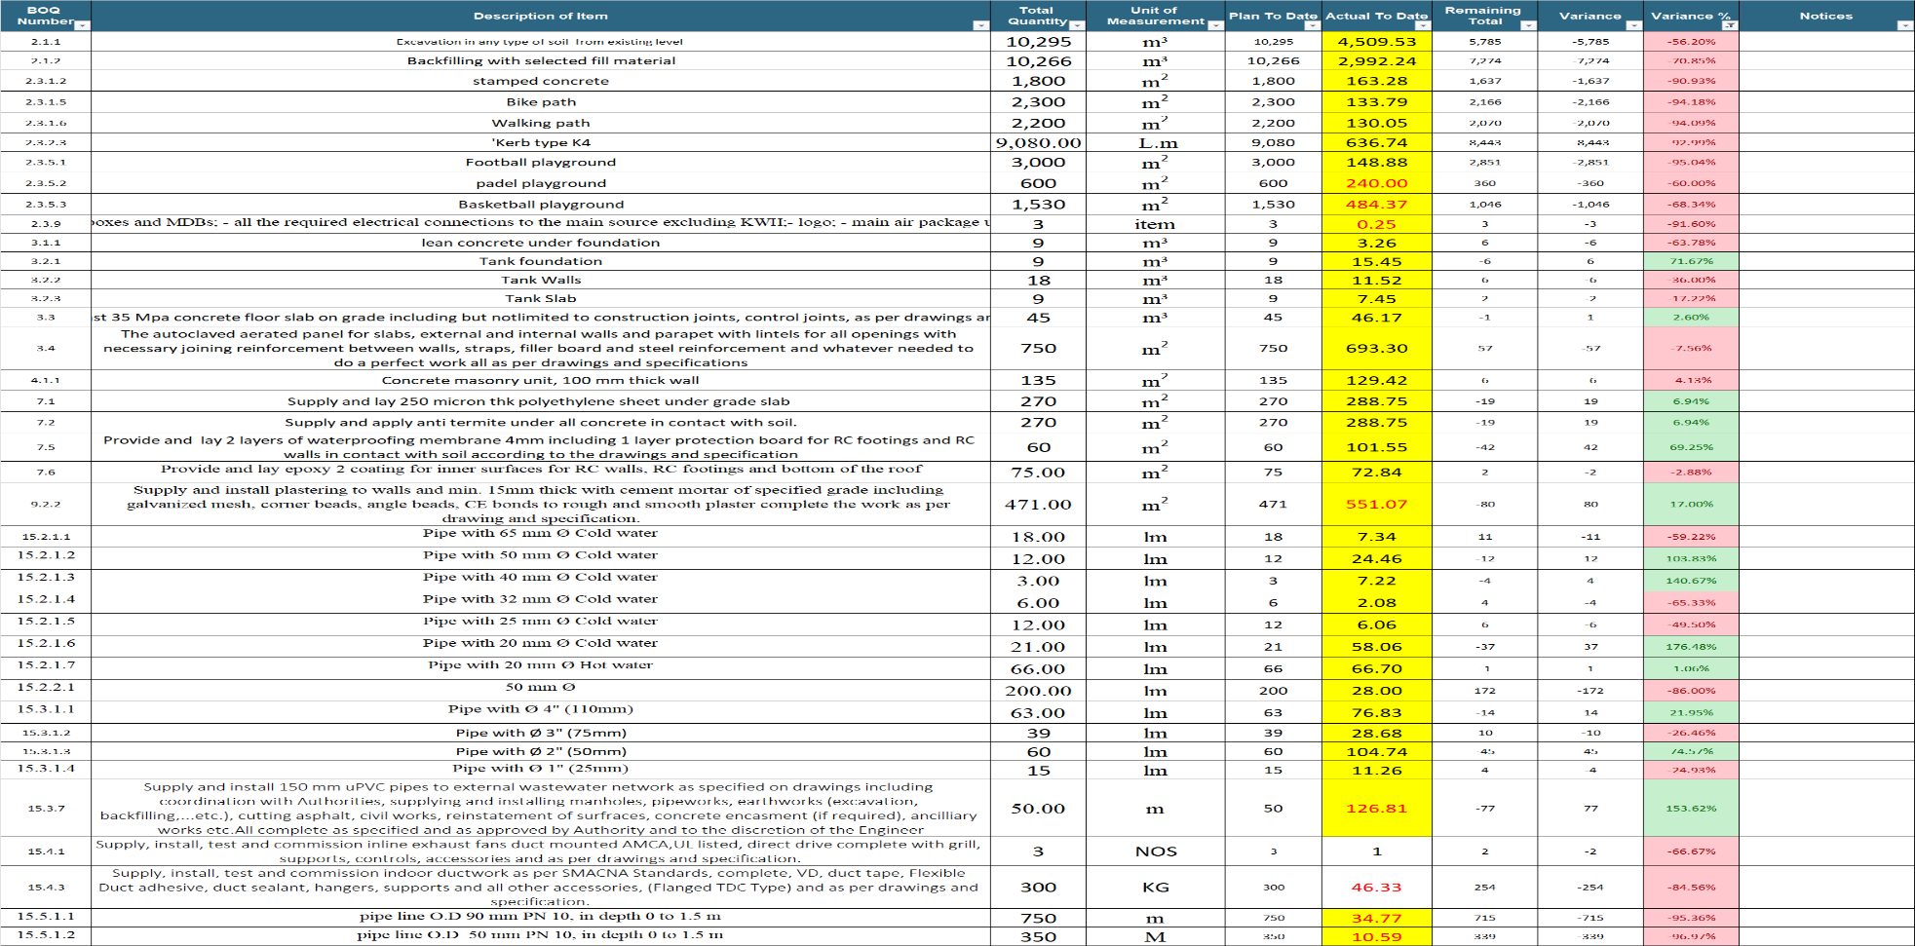
Weekly Report Areas / Quantities
Major Quantity Trackers

Slide 24

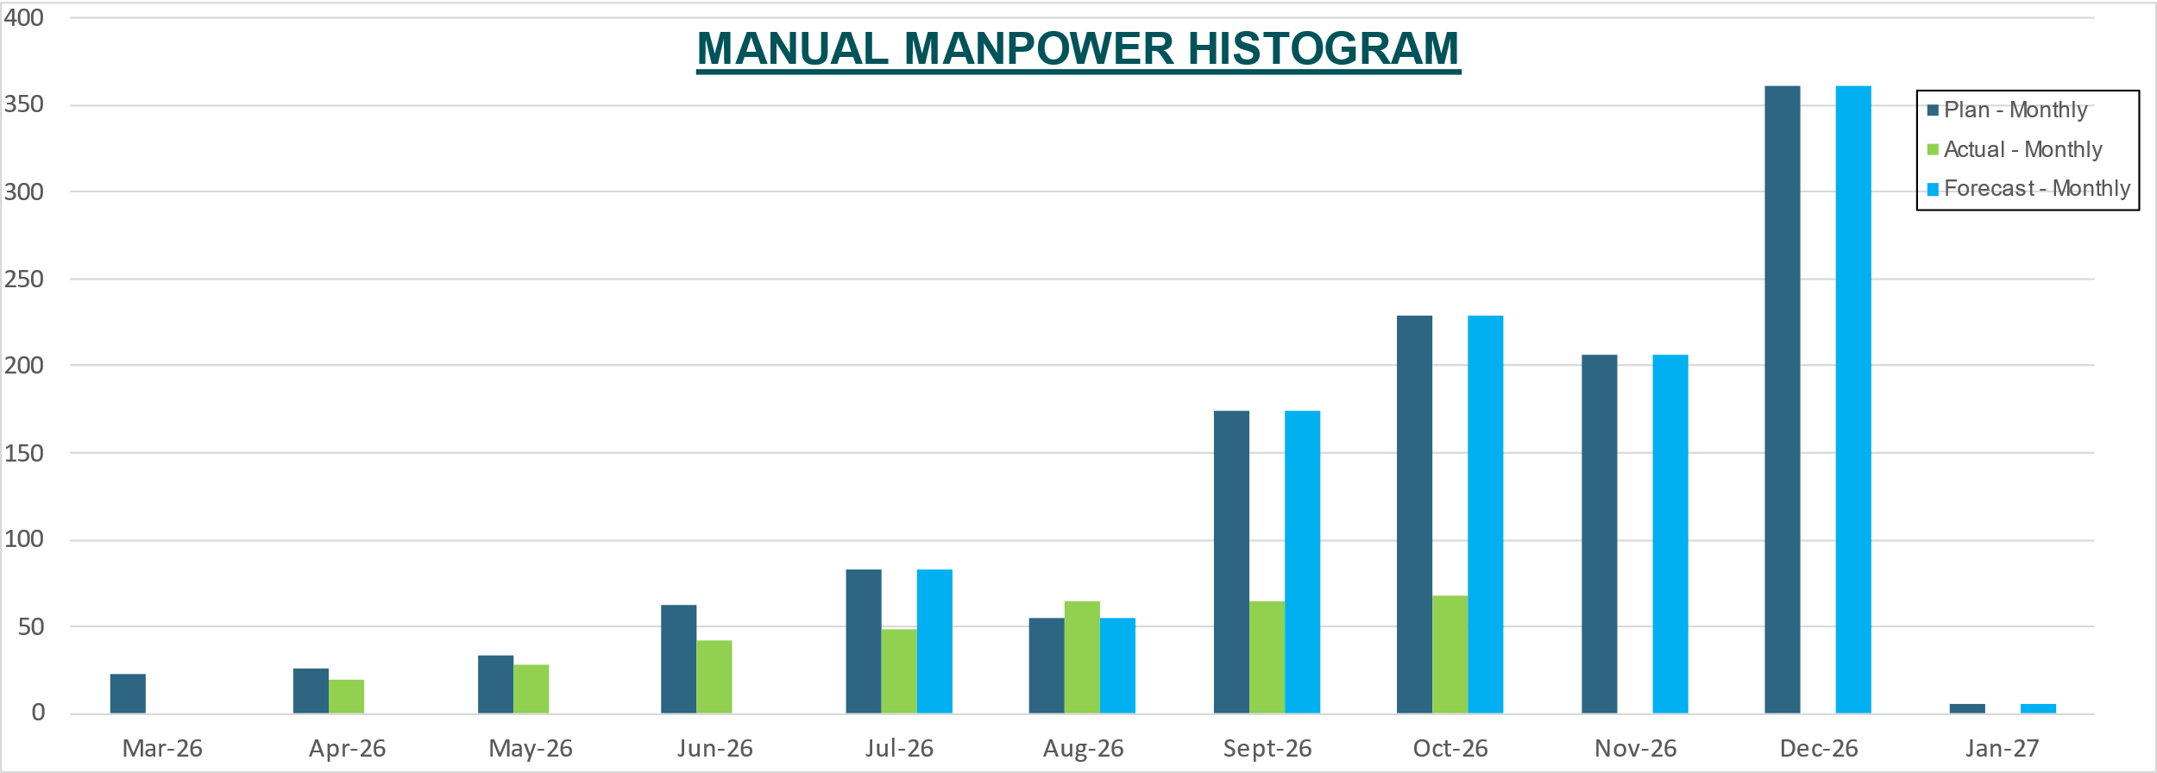
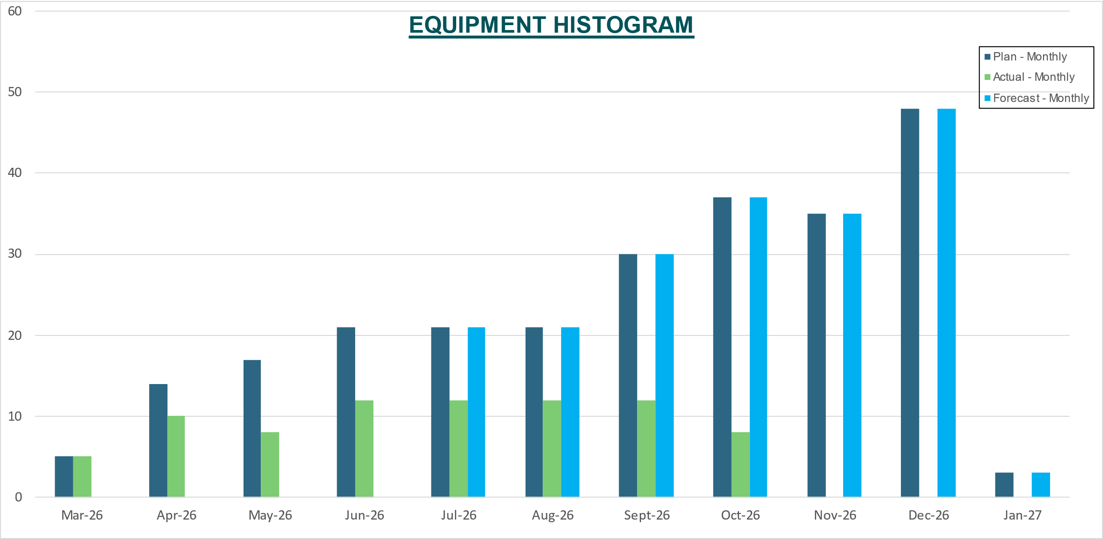
Weekly Report Areas / Resources
Resources

Slide 25
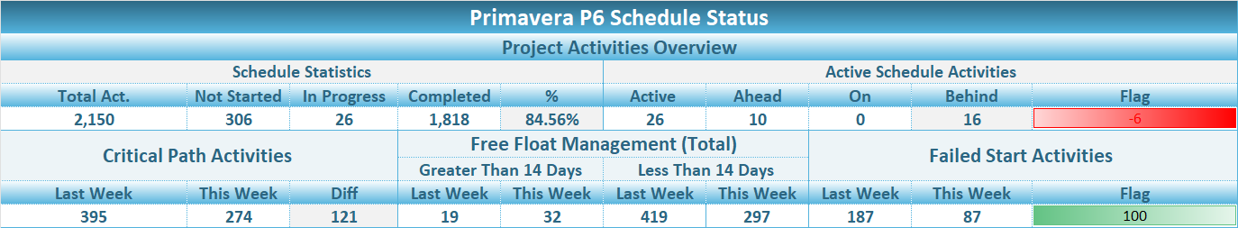
Weekly Report Areas / Schedule Status
Primavera P6 Schedule Status

Slide 26
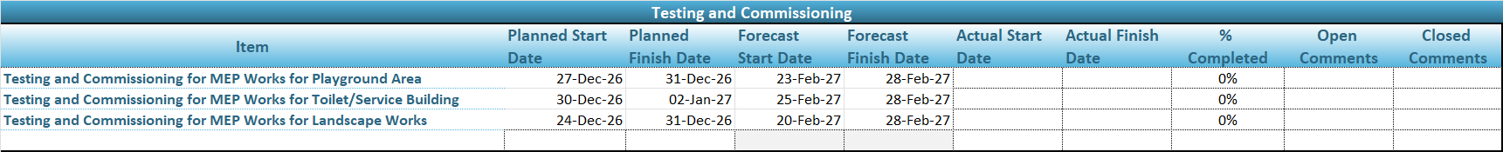
Weekly Report Areas / Testing and Commissioning
Testing And Commissioning

Slide 27
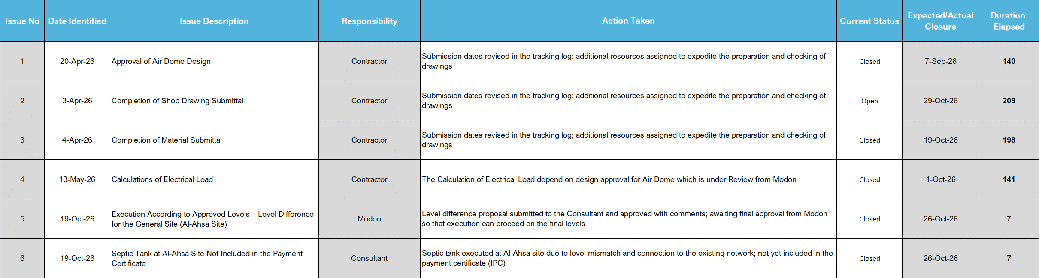
Weekly Report Areas / Issues
Active Issues

Slide 28

Thanks

